Slide 1
Saving Collections: Build Your Disaster Plan
Session 4: May 10, 2021
Welcome!
Today’s Program
Round Robin
Evaluation & Wrap-up

Slide 2
Emergency Plan Framework
Institutional Information (NEDCC 3.4, A)
Services Needed in an Emergency (NEDCC 3.4, B)
Risk Assessment Checklist (NEDCC Preservation Education Curriculum)
Risk Prioritization Worksheet (Foundation for Advancement in Conservation)
Emergency Equipment & Supplies(NEDCC 3.4, C)
Other Issues [Training, Drills] (NEDCC 3.4, G)
Salvage Priorities(NEDCC 3.4, I)
Additional Sources of Emergency Equipment & Supplies (NEDCC 3.4, D)
Drying Station Locations (NEDCC 3.4, H)
Salvage Procedures (NEDCC 3.4, J)
NOW: PUT IT ALL TOGETHER

Slide 3
Round Robin (at the end)
What was the biggest, best, most important part of trying to create a meaningful emergency response plan?
What was the hardest, most challenging, and/or part you liked the least during the process?
What are your next steps?

Slide 4
Sustainable Emergency Planning
Karen E. Kiorpes, University at Albany SUNY
Sponsored by the
Capital New York Alliance for Response

Slide 5
Your Plan In Writing
GET ORGANIZED
Compact
Easy to access the information you need
Ring binder
Table of Contents, proper pagination
Tabbed and numbered or labeled, critical information up front, appendices
Start with the basics/essentials and develop the plan over time

Slide 6
Outline of the Plan
1. Front Cover:
“Emergency Response Plan for….”
Date or Revised Date
Where the plan is located (physical locations and remote)
Who in your organization has copies
Date of next scheduled update (usually 1 year or sooner if something big changes)
2. Table of Contents
Summary Procedures, After Hours Emergency, Emergency Call List, Salvage Procedures
Appendices

Slide 7
Outline of the Plan
3. Scope of the Plan
1 space, 1 building, building and site, etc.
Any other policies or procedures associated with the plan
Who drafted the plan (acknowledgements)

Slide 8
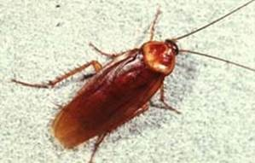
Outline of the Plan
4. Summary of Procedures –
What to do right away!!!
Who to contact and contact information (repeat!)
Reporting and documentation
Fire
Flooding, Water Damage
Blackout, Power Outages
Medical Emergency, Personal Safety Incident (threats in progress), Bomb Threats
Vandalism in Progress
Systems Emergency
Snow Emergency
Pests and Mold
Building Closure
Link to (Campus) Emergency Plan

Slide 9
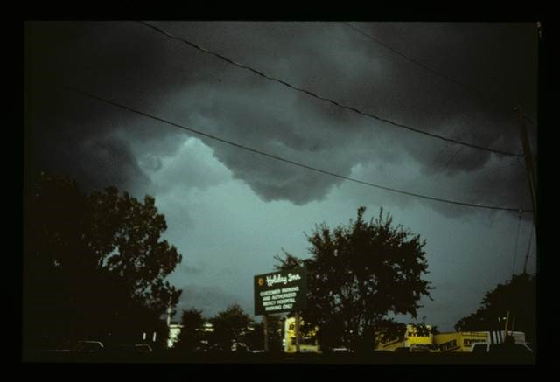
Outline of the Plan
5. After Hours Emergency
Cell phone, home phone, alternates (building managers, key responders)
Who will contact you after hours? UPD, private security, local police/fire
Find out the exact nature of the emergency:
Flooding? Intrusion alarm? Fire alarm? Power failure? Suspicious activity? Problems with the building or its systems?
Find out who else they have contacted. If they haven’t contacted key individuals plan to do so
Do not take personal safety risks if you come to your site late at night
Be prepared: protective clothing,
your copy of the Plan, keys, ID, flashlight,
extra batteries, cell phone AND charger,
other tools (pocketknife, laptop), personal items

Slide 10
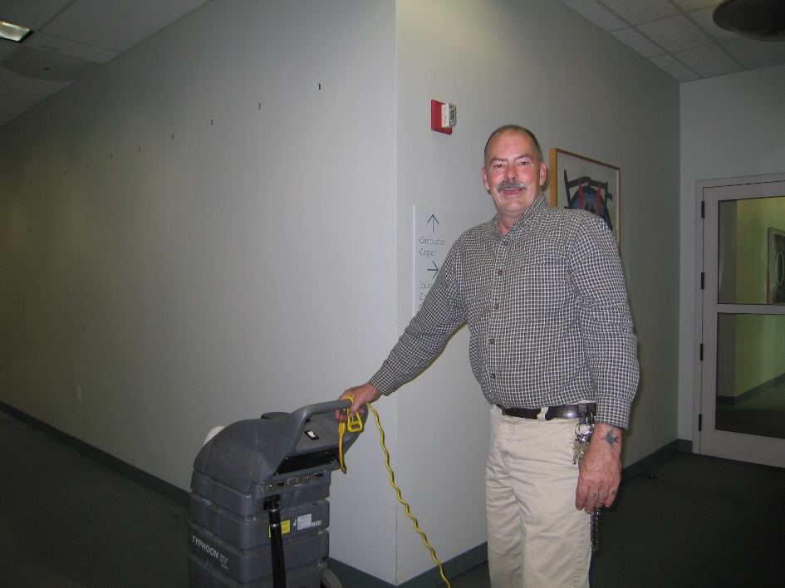
Outline of the Plan
6. Emergency Call List
Cell phone, home phone, alternates – more details
Administration, Security, Medical Emergency, Health and Safety Officer
Emergency Response Coordinator (usually facilities manager, dean/director)
Emergency Recovery Coordinator (collections specialist)
Salvage Team

Slide 11
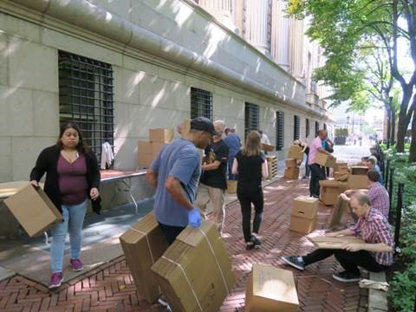
Outline of the Plan
7. Salvage
Initial Preparation – first responders: who to call, where to meet, brief
Salvage Operations – command center, additional personnel, assign roles/responsibilities, establish a staging area
Documentation
Remove/stabilize priority materials
Pack and remove undamaged materials
Stabilize low-priority items
Communication (who can and cannot talk to the media!)
Staff organization
The building
Packout instructions – sorting, tracking/labelling
Salvage by format (books, flat paper, photographs, oversize materials, etc.)

Slide 12
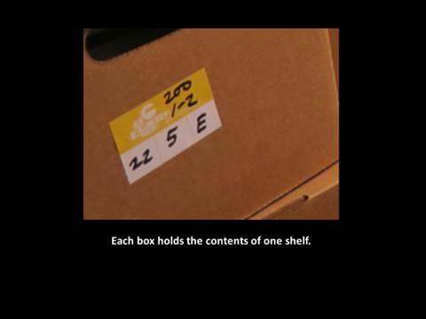
Outline of the Plan
8. Appendices – the details go here!!!
Evacuation procedures (someone else in your organization probably did this for you)
Emergency Suppliers and Services
Report Forms
Location and contents of disaster kits
Floor plans
Collection priorities
Instructions for freezing, rinsing, drying
Any other applicable or related plans maintained by others

Slide 13
Outline of the Plan
Questions before we move on???

Slide 14
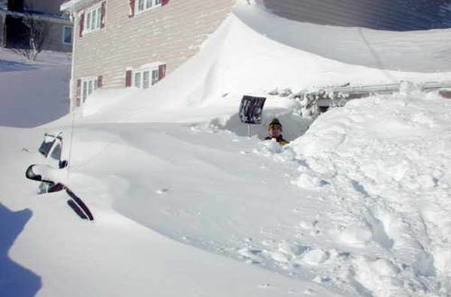
Access the Plan 24/7/365 No Matter What
Print copies in key locations and with critical players
Circulation desk, reference, office and home copies, UPD, etc.
Online access – with secure sign-on
Other ideas???

Slide 15
Training: It’s REALLY Important
Familiarize staff with the organization, contents and application of the plan; get their input to make it better
Know how to respond to be effective, efficient and make the best decisions under stressful conditions
Anyone can be the first on site – build confidence, skills, knowledge
Understand the capabilities and limitations of your team

Slide 16
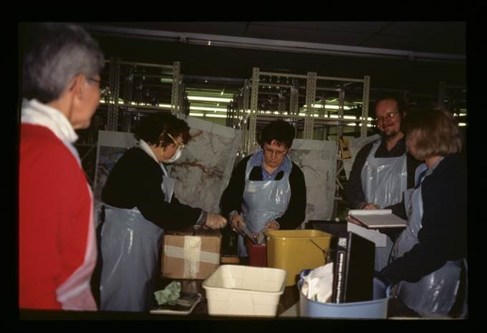
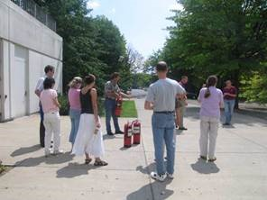
Training Options and Opportunities
In-house:
Tabletop: scenarios that test parts of your plan, practice using the plan, build teamwork, test the plan and aid in revision
Hands-on: salvage and stabilization techniques
Situational: communication and coordination with other players (UPD, etc.), know what to do and make decisions under stress; evaluate response

Slide 17
Training Options and Opportunities
Online:
Library of Congress: “Level of Collections Emergency Scenarios”, https://www.loc.gov/preservation/emergprep/plan/scenarios.html
Archives Society of Alberta: “How-to Videos”,
http://archivesalberta.org/programs-and-services/disaster-preparedness-and-recovery/how-to-videos (handling wet paper, packing and drying wet records)
University of Illinois: “Disaster Preparedness for Libraries/Videos”, https://guides.library.illinois.edu/c.php?g=1061154&p=7790977
FEMA: “Introduction to the ICS”, https://training.fema.gov/is/courseoverview.aspx?code=IS-100.c

Slide 18
Training Options and Opportunities
Questions???

Slide 19
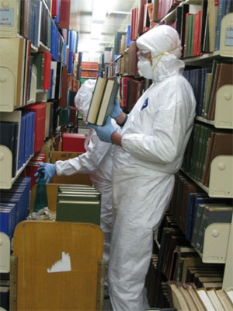
Round Robin
What was the biggest, best, most important part of trying to create a meaningful emergency response plan?
What was the hardest, most challenging, and/or part you liked the least about the process?
What are your next steps?

Slide 20
Evaluation and Wrap-Up
We will be assigning a Mentor to each participant who you can work with this spring/summer to polish your plan
A link to the Evaluation will be sent to everyone asking for your input!
Thanks to the CapNYAFR Advisory Board, NEDCC, and our many talented speakers
And special thanks to all our participants for joining us and working through the planning process

Slide 21
THANK YOU!!!
Karen E. Kiorpes, kkiorpes@albany.edu
Donia Conn, conn@simmons.edu
Maria Holden, msholden1@aol.com
John Diefenderfer, john.diefenderfer@nysed.gov

