Slide 1
Saving Collections: Build Your Disaster Plan
Session 2: Response and Recovery
Welcome!
Introduction to today’s program
Keynote presentation—Donia Conn
Q & A / Discussion
Wrap-up

Slide 2
All Hands on Deck: Disaster Response and Recovery
Sponsored by the
Capital New York Alliance for Response
11 January 2021

Slide 3
Today’s Agenda
Review of Risk Assessment
Disaster Response
Salvage Priorities
Salvage Techniques
Q and A

Slide 4
Review of Risk Assessment
Don’t skip this step, it is an important information gathering process
Identify risks inside and outside, attic to basement, roof to foundation, human, mechanical, and technical, and from your building and lot to your neighborhood and region.
Get to know the people involved in the management, maintenance, and services provided to your institution.
Notes:
The people you put in parts A and B of your plan from part 1 assignment should be more than just a phone number or email – start building relationships now as the stronger the relationship at the time of a disaster, the better the response by all parties.

Slide 5
Disaster Response

Slide 6
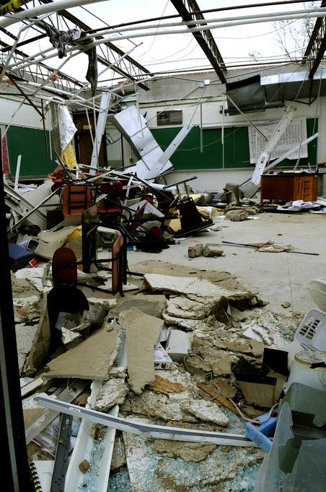
Response
Strategic Priorities – The 3 S’s
personal Safety
property Stabilization
collection Salvage
Photo by Barry Bahler/FEMA - May 27, 2008 - Location: Parkersburg, IA
Notes:
Good decisions are never made in a panic. Stop, think, decide, and be able to change course when you need to. Rigidly adhering to perceived ideals will do more harm than good but be sure to take a stand when necessary.
Strategic Priorities
Personal Safety
Property Stabilization
Collection Salvage
Only after staff is evacuated and accounted for do you move to the next phase where you look at the problems to be addressed in order to stabilize the situation or keep it from cascading into a more complex or dangerous one. Only after life safety and site stabilization actions have been completed do you transition into the property phase where the collections take priority. Never forget these three S’s.

Slide 7
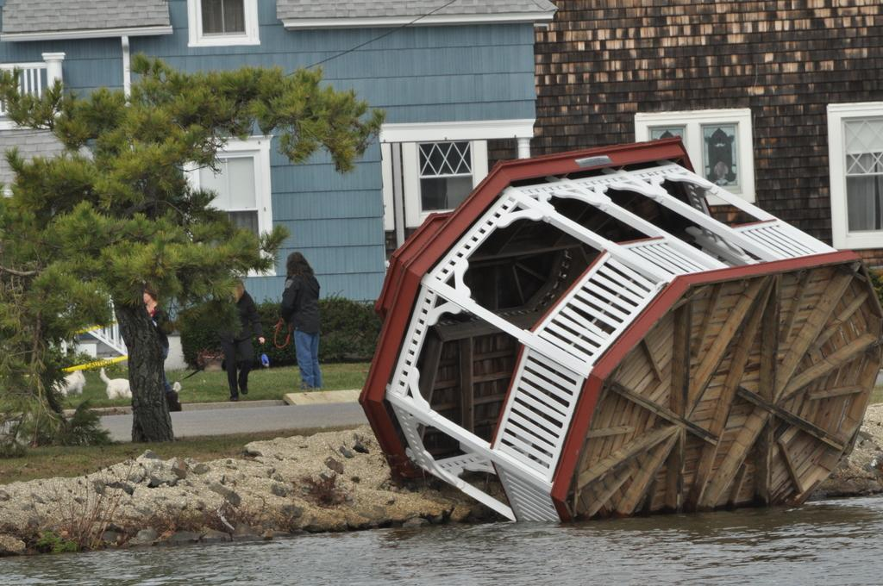
Collection Response Phases
Response
Review, assess, plan
Triage/Salvage
Recovery
Photo by Sharon Karr (via FEMA) - Nov 02, 2012 - Location: Asbury Park, NJ
Notes:
The first step in the response phase is to take the time to review and assess the incident. The next step is to evaluate the information and plan for the logistics of triage and salvage. Recovery will be the long-term work of restoring the collection, building, and services to full functionality.
We will be covering each of these steps in depth through this workshop.

Slide 8
Review
Notes:
The three main areas to review during an initial response are your disaster plan, supplies and equipment, and people. At this time, the latter two areas will focus on both personal safety and property stabilization.
So, ask yourself:
What sort of a disaster was it?
Is it safe to enter the building yet?
What do we need to protect staff (PPE, protective clothing, etc.) when they can get into the building?
What equipment do we need to stabilize the environment within the building?
Do we need a generator? Do we have a hookup?
What supplies will we need to protect the collections from further environmental harm?
Who are we going to need to help us salvage the collection?
These questions are often easy to answer even before you can get into the building from discussions with first responders and with your facilities staff.

Slide 9
Disaster Plan
Notes:
Remember from the emergency management program we talked about earlier, response is putting preparedness plans into action and includes both life safety and site stabilization needs before you turn to recovery.
While you wait to gain access to your building or for quick reference after a smaller disaster, review your disaster plan individually as well as with your disaster response team so everyone knows what to do and who will be doing what.

Slide 10
Personal Protective Equipment (PPE)
Gloves
Leather for heavy clean-up
Nitrile or latex for handling collections
Masks
N95 or N100 particulate
Goggles or other eye protection
Protective clothing
Tyvek coveralls or aprons
Notes:
We talked about PPE for mold in the pre-workshop preservation program but for disaster response, you start adding more. Preferably you have work gloves, hard hats, headlamps, masks, and steel-toed boots for working to remove debris in order to get to the collections. You would then have nitrile gloves, masks, waterproof aprons, goggles, and waterproof boots to work with damaged collections, wet materials, and potential mold.

Slide 11
Vendors
NHR volunteer Hitoshi Kimura working on the FIRST painting at the Haiti Cultural Recovery Center
Notes:
When you experience a large disaster – generally meaning over 100 objects/books/boxes of documents being wet or damaged – you will want to review your vendor relationships. We will talk about when and how to work with vendors in the third webinar.

Slide 12
Assess
Notes:
Once you have access to your building or once the active emergency has been brought under control, it is time to assess the incident as a whole. This is incredibly important for planning purposes and will result in a more efficient and cost-effective response.

Slide 13
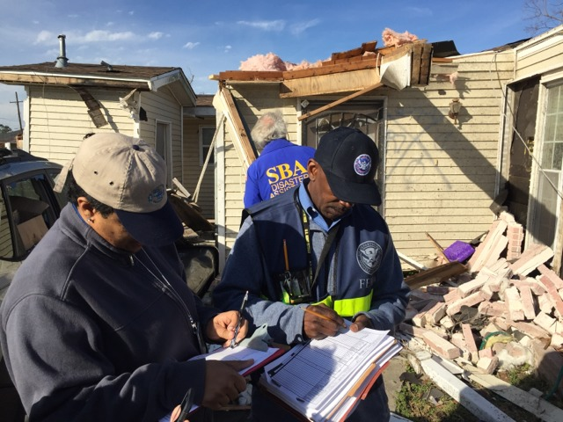
Damage Assessment
Assessment Team
3-4 people
Assessment Timeframe
15 – 20 minutes
Assessment Activities
Photodocumentation
Building needs
Health and safety considerations
Collection needs
Assessment Objectives
Type of damage
Cause of damage
Location of damaged collections
Volume of damaged collections
Photo by Robert Kaufmann/FEMA - Feb 09, 2017 - Location: New Orleans, LA
Notes:
The objectives of the assessment phase are to gather critical information on the status of the damage and to bring back the information to the team to evaluate the findings. This initial assessment should only take 15-20 minutes. We aren’t going for detail here, rather, we want the big picture. From the findings you will develop an incident action Plan (IAP)
Your only task during an assessment is to document what you see. DO NOT begin salvage efforts! Using a team approach during a time of stress will make the next step of evaluating the information and crafting an action plan much easier and more accurate. The more eyes you have the more information will be brought together as a result of the collaboration.
In the 15 to 20 minute assessment, you will be taking notes on the type, cause, location, and extent of damage to the building and collections. These notes will be gathered by category: health and safety considerations, building needs, and collection needs (sound familiar?). Each member of the team will be responsible for one category. Along with taking notes, the assessment team will be taking digital images of overall conditions and some detail shots when necessary. This is the primary job of the recorder, if there is one, or of one designated person on the team. Since the team only has a short period of time, the photo documentation is crucial.
Three pairs of eyes are better for safety and for observation. A camera is a core piece of equipment.

Slide 14
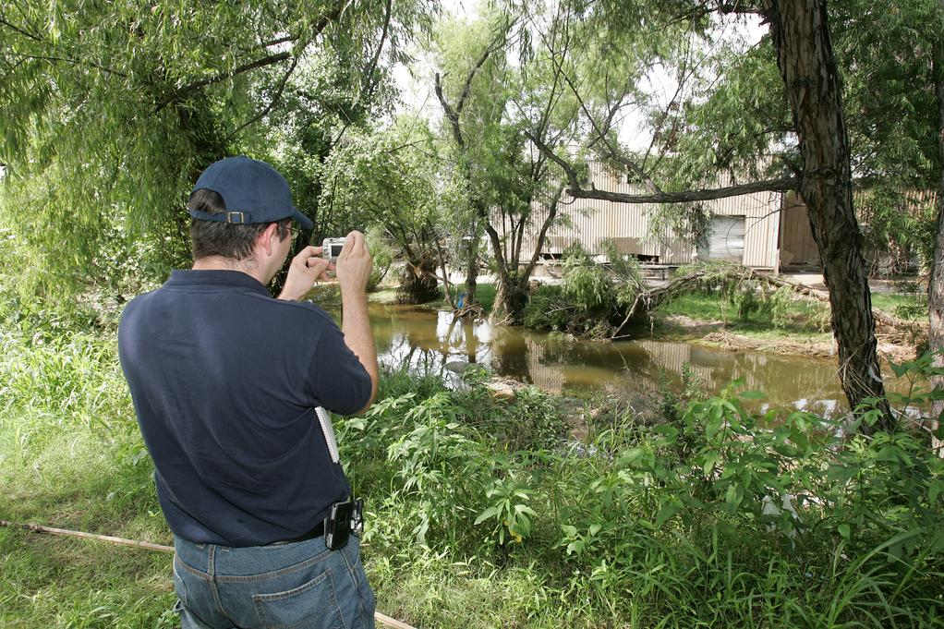
Photodocumentation
Photo by Bob McMillan/FEMA - Jul 02, 2007 - Location: Marble Falls, TX
Notes:
Documenting what you see is important. The use of a digital camera is essential as those images will capture information the assessors may have overlooked.
The images taken during the assessment will be valuable for a multitude of needs: insurance documentation, collection records, health and safety needs, building condition, and more. Photo documentation is necessary for recovery planning and is often a dramatically useful tool for public relations. At the end of your recovery period, the photos also provide reminders for a debriefing discussion and the After Action Report. Debriefing and the report will provide a formal record of what went well and what areas need improvement after a disaster.
Drones can also be a helpful tool in performing your damage assessment. Before a disaster, check with your local fire department or emergency management office to see what the rules are and to see if they can help in a disaster situation. The NYS Dpt. Of Homeland Security and Emergency Services can use drones for a variety of public safety/emergency response purposes including conducting damage assessments so find out what the criteria is for this use in your area.

Slide 15
Building Needs
Photos by Alex Allardt
Notes:
Document the environment no matter how obvious it is. In this example no heat is available. There is an extensive amount of mold growing in the basement. It is wet, cold; there is no electricity for either dehumidification or a sump pump. How is the structural stability of the building? What security issues are there?
This damage assessment will identify the problems. When you confer with the incident commander (IC). Your discussions of observations will guide you in determining the appropriate quantity of generators, security lighting, security guards, or skilled carpenters. It will help identify health and safety hazards, such as the mold bloom in the structural beams noted here.

Slide 16
Health and Safety Needs
Structural instability
Electrical systems + water
Natural gas, liquid propane, fuel oil lines
Physical hazards (tripping, slipping, straining)
Wild animals
Chemical exposure (asbestos, carbon monoxide, lead, arsenic)
Mold
Photo by John Shea/FEMA - Jan 14, 2005 - Location: La Conchita, CA
Notes:
A third topic for documentation is the kinds of safety hazards present including the types of damage to facilities. Prior to entering the facility, be sure to confirmthat any electrical, gas, and oil systems have been shut down! Safety hazards to watch out for include any gas or oil spills, physical (tripping, slipping, straining) hazards, any evidence of wild animals (raccoons and squirrels can get very angry during a natural disaster and snakes are always best avoided), what chemical exposures are possible (asbestos, carbon monoxide, arsenic), and the presence of mold.

Slide 17
Not All Water is Equal
Photo by David Fine/FEMA - May 03, 2010 - Location: Nashville, TN
Notes:
When we are responding to a disaster, one of the most important questions we need to ask ourselves is, if water is involved, what sort of water do we have?
Clean Water
Water from a source that does not pose harm to humans
Sprinkler systems, burst pipes, fire hoses
Grey Water
Water containing a significant amount of chemical, biological, or physical contamination.
Has the potential to cause discomfort or sickness through consumption or exposure
Waste water from sinks, showers/baths, dishwashers, clothes washers
Black Water
Unsanitary water containing pathogenic agents
Likely to cause discomfort or sickness through consumption or exposure
Sewage, flood waters from rivers/streams, surface water

Slide 18
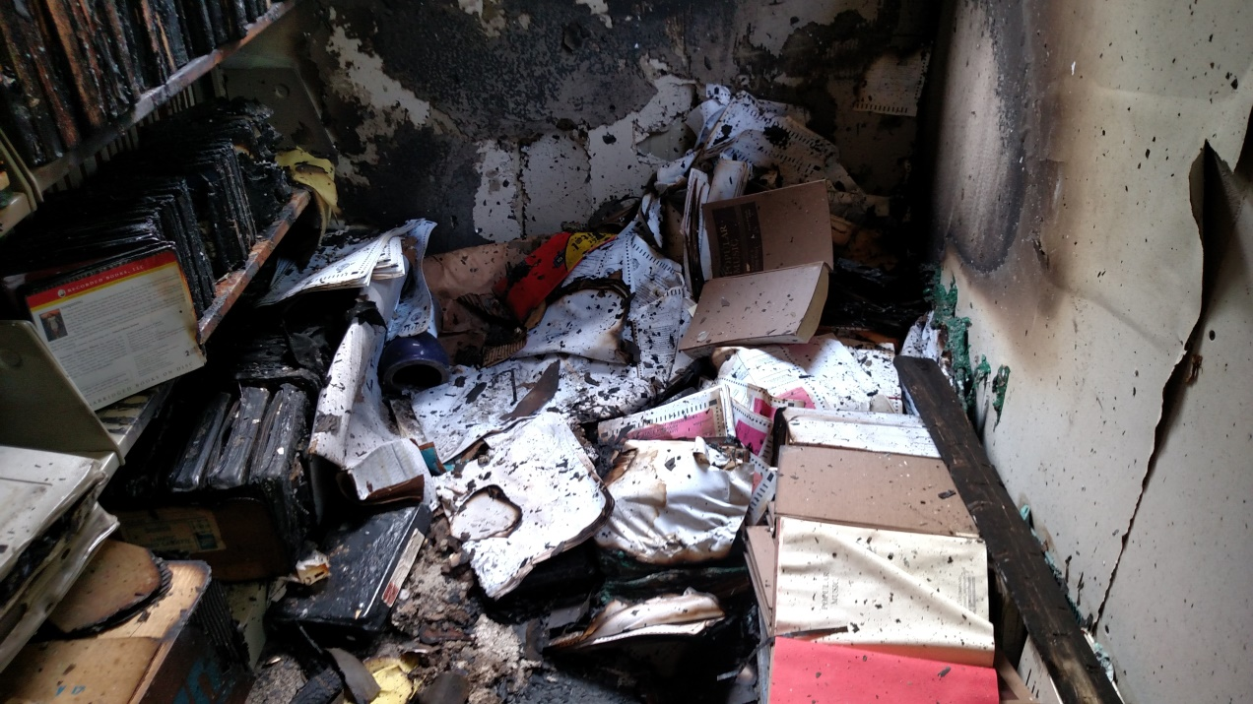
Collection Needs
Notes:
How much material was affected?
What kinds of materials are involved?
What kind of damage is involved?
What is the value of the material?
What damaged materials are necessary for the operation of the institution?

Slide 19
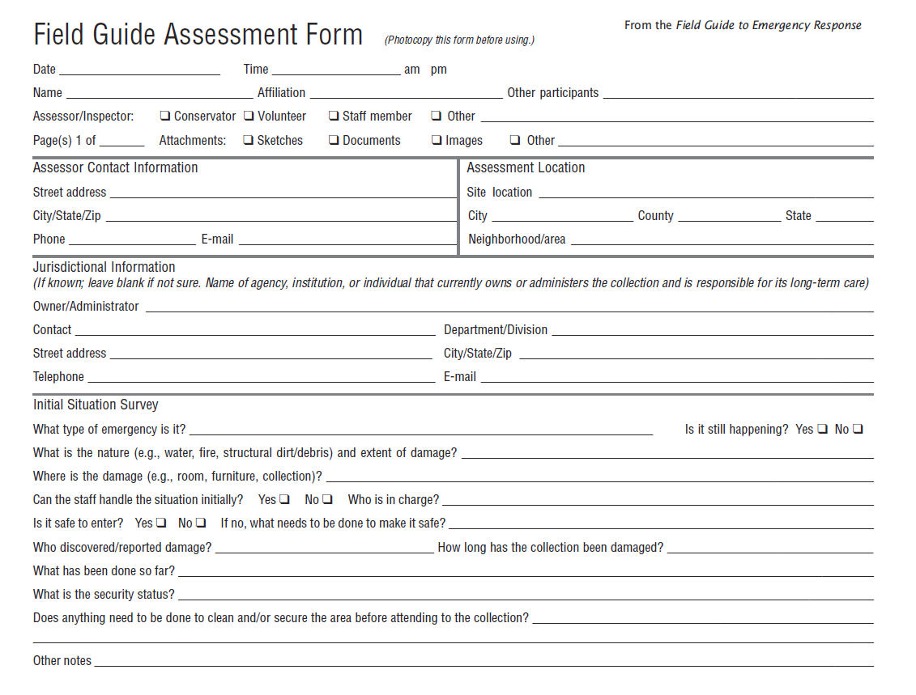
Assessment Forms
Notes:
The two-sided form found in the Field Guide to Emergency Response can be reproduced to help streamline collecting information on the type, cause, location, and extent of damage to the building and collections. Having standardized forms means that if you send in different teams to different areas, the information collected will be consistent.
Type of damage
Cause of damage
Location of damaged collections
Volume of damaged collections

Slide 20
Plan
Notes:
Planning is critical to the success of any response and recovery effort. Never skip this important step!

Slide 21
Evaluation & Planning
Assess
Classify
Prioritize
Notes:
Once the assessment has been done, the disaster response team as a whole will meet to assess the information, clarify any discrepancies or questions, and prioritize activities. For example, if you are looking at the environmental stabilization needs, ask
What are the tasks that need to be completed to stabilize the affected areas?
What equipment is needed?
What outside services are needed?
Do we need additional staff to isolate the affected area?
Once an evaluation is done, begin to formulate an Incident Action Plan (IAP) that will identify tasks that need to be done and who will do them (staff or vendors). Some questions to ask straight from your disaster plan:
Where are you going to coordinate your response?
How will you ensure the safety of your staff and volunteers?
How you will manage site security?
Who do you need to contact?
Do you have existing contracts in place?
Do you know where they are and what they say?
As an example, here is one approach to an incident action plan for a large water incident:
The liaison officer (staff) is tasked with contacting vendors, the water damage team (staff) is tasked with inspecting the building for signs of water damage and structural risks, and the preparation team (staff or vendor) is assigned to repair electrical and utilities. Only after these teams report back to the incident commander that all life safety and building stabilization issues are addressed can an institution transition into collection preservation tasks. However, during that time when life safety and facility stabilization efforts are being undertaken, the collection team will be implementing their own IAP by working with the liaison officer to set up triage facilities, contact vendors or specialty conservators, and contact buddy institutions for extra hands for sorting and triage efforts. No time is wasted, once the site is considered safe.

Slide 22
Incident Action Plan
Notes:
From the assessment information, the incident commander will develop an incident action plan that identifies staffing tasks and vendor needs. It will lay the groundwork for the recovery and salvage efforts.
Following the structure of unified command, as shown here, the incident commander has a team of two: a preparation strike team and a water/damage assessment strike team. The preparation team is tasked with removing electrical cables, restoring power, and gathering supplies. The water/damage team is tasked with inspecting the building from basement up to verify there is no other damage. A special instruction to the preparation team reminds them to not restore power until complete verification that no electrical cables or other hazards remain to be dealt with. This special instruction shows the importance of a single commander who sees the big picture and ensures all teams know what their role is.

Slide 23
Salvage Priorities

Slide 24
Salvage Priorities
Collections to be considered as priorities for salvage:
Materials that support your institution's primary mission
Unique collections
Heavily used collections
Collections with legal retention requirements
Collections that are difficult or expensive to replace
Collections with scholarly research value
Collections with monetary or artifactual value
Formats that are particularly vulnerable to damage (e.g., paintings)
Materials on loan
Notes:
The most often skipped section of a disaster plan is collection prioritizing it is often difficult to come to a consensus on collection salvage priorities. These will not always be easy to set and should include input from all departments. Salvage priorities are not those things that should be grabbed when the building is on fire but those things that you will take care of first when you get access to your building again. Human safety is the most important element in disaster planning.
When determining salvage priorities, first ask yourself what the most important COLLECTIONS (not individual items, necessarily) are to save.
You also want to ask yourself what is replaceable. If an item can easily be replaced, it should not be a priority unless there are specific provenance issues. In many instances, it is less expensive to replace than salvage – especially for a public library or general circulating library collections.
Don’t forget to consider digital assets in the above categories! If you don’t have backups of some of your digital collections, include them in your priorities or make a point to have good backups of all digital collections and systems.

Slide 25
Words and images
Notes:
Be sure to not only have a list of collections but also have some way to locate those collections within the institution. It often helps to create a map with color-coding. Some disasters will strew collections all over and having some relational guide to debris can be invaluable during salvage.
Maps can be detailed and laid out clearly or…
Be as simple as you want.
No matter what you do, be sure to make the maps as clear as you possibly can.

Slide 26
Salvage Options

Slide 27
Dehumidification/Desiccant Air Drying
Advantages
Scalable – works for large or small disasters
On- or off-site but always done by a vendor
Collections accessible during drying
Disadvantages
Labor intensive
Does not work for clay-coated papers
Notes:
Undertaken in a controlled low humidity environment – below 20%RH – and with a temperature of 75-80 degrees F.
Temp in conjunction with air circulation speeds drying.

Slide 28
Air drying
Advantages
Best procedure for drying small numbers of objects
Often the least expensive in terms of immediate cost
Disadvantages
Limited by availability of trained professional, staff, and volunteers – as well as space
Distortion or damage to items requiring treatment after drying
Risk of mold increases when items dry too slowly or are not thoroughly dried before returning to storage.
Notes:
This is the preferred method for photographic prints, paintings, and many other objects we will discuss in a bit.
The process is labor intensive, hence the need for staff, hours, and space.

Slide 29
Freezing
Advantages
Best procedure for stabilizing large number of items, can be done in batches
Recommended if you cannot attend to wet materials within 48 hours, when mold growth is most likely
Disadvantages
Some distortion will result in paper- and other cellulose-based materials
Some items should not be frozen as considerable damage can occur
Notes:
You can dry things by simply freezing (think freezer burned chicken breasts) but it takes a long time and only really works for items that are wet around the edges or are moldy.

Slide 30
Vacuum freeze-drying
Advantages
Vacuum reduces warping of materials
Costs only slightly more than air drying when treatment costs are factored in
Disadvantages
Be cautions of vendors with older equipment as can use too much heat and be damaging.
Not appropriate for photographs
Notes:
Best for library and archival materials.

Slide 31
Conservation
Do you have important collection items that cannot be frozen and need special treatment in the event of a disaster?
Do you have a prior relationship with a conservator?

Slide 32
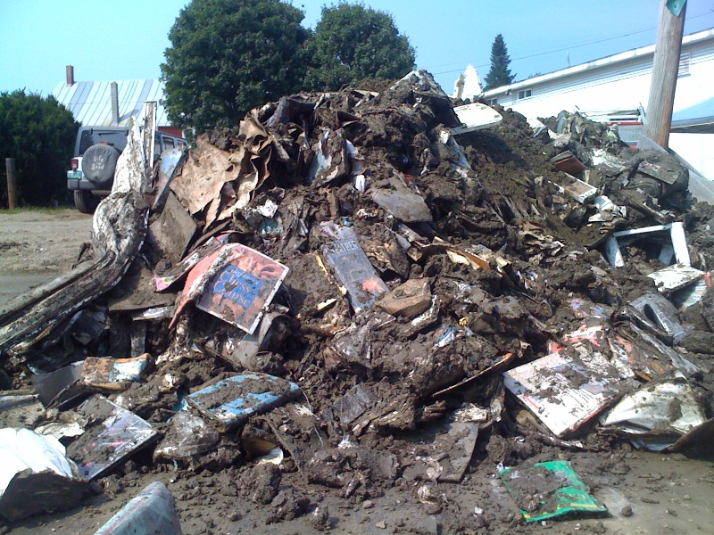
Discard
Are materials replaceable?
Is it more cost effective to replace?

Slide 33
Other Considerations for Salvage
What are your salvage priorities according to your disaster plan?
Are any materials needed for the day-to-day operations of the institution?
Are there any materials that cannot be frozen?
Do not freeze:
Magnetic Media (audio/video tapes, floppy disks, etc.)
CD’s/DVD’s
Vinyl LP’s or other records
Cased photographs and color transparencies
Glass negatives or lantern slides
Microfilm and motion picture film
Paintings

Slide 34
Library and Archival Materials
Salvage Techniques
Notes:
The following salvage techniques are for small disasters that you have the staff, time, space, and expertise to handle on your own. Refer to the “Salvage at a Glance” handout and the salvage wheel for quick reference during a disaster.

Slide 35
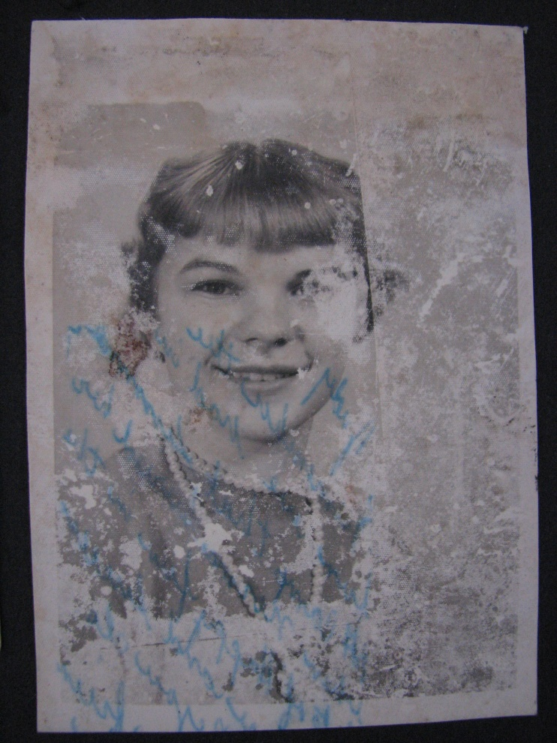
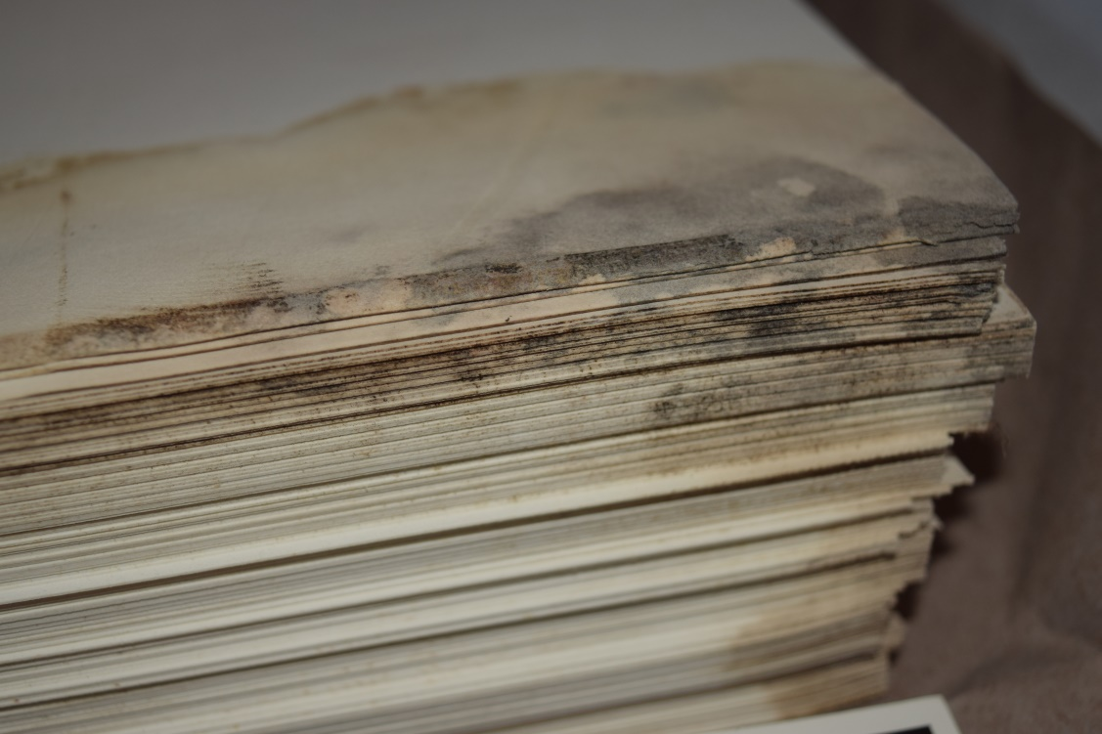
Risks to Paper-based Materials
Running inks/colorants/dyes
Mold
Blocking of clay coated papers or photographs

Slide 36
Packing out Needs
Boxes, plastic garbage bags, wax paper, blotter, pencils, permanent markers, note pads
Packing containers should be:
All the same size
Able to support the full weight and dimension of the contents
Stackable
Small – remember wet items are much heavier

Slide 37
Packing out Process
Line cardboard boxes with garbage bags if collections are very wet
Clear the floors and aisles of tripping hazards first
Box materials as they are on the floor
Place waxed paper between items to prevent staining or blocking
Pack out priority items first, then the rest of the materials from wettest to driest.
Keep accurate records of what is in each box and where it is going.

Slide 38
Preferred salvage options for paper-based collections
Air dry – In-house
Freeze – In-house or vendor
Vacuum freeze dry – Vendor
Send to a conservator immediately (rare or unique items)
Discard
Notes:
From our list of options earlier…

Slide 39
Museum Collections
Salvage Techniques
Notes:
The following salvage techniques are for small disasters that you have the staff, time, space, and expertise to handle on your own. Refer to the “Salvage at a Glance” handout and the salvage wheel for quick reference during a disaster.

Slide 40
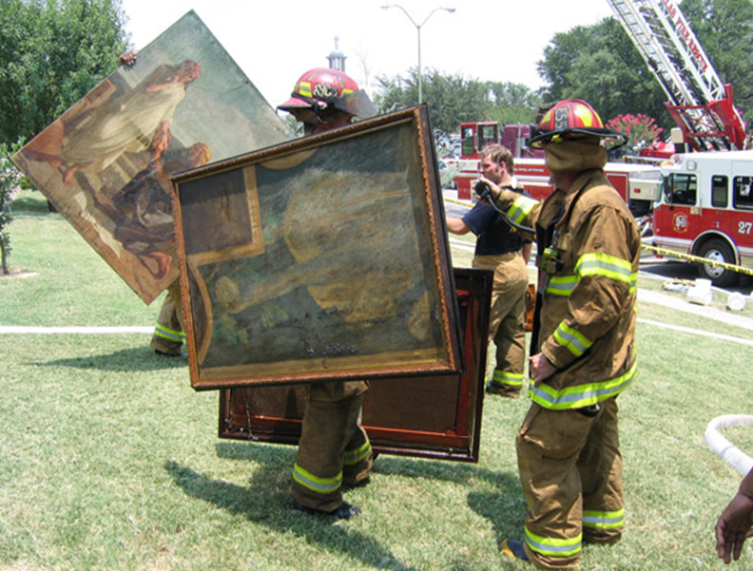
Risks to Paintings
Weak wet strength
Tears, punctures, holes
Water soluble layers
Hardware wires
Canvas distortion
Dirt/soot
Mold contamination
Ornate frames
Notes:
Paintings and their frames are readily damaged by water, caustic agents, extremes in t &RH insect infestation and impact.
Wooden frames and paintings on wooden panel supports are especially reactive, but paintings on canvas are very easily damaged as well.
When wet or when subjected to drastic changes in T, the support layers can expand or shrink causing paint and gilding to flake, tent and separate from underlying layers
Because canvases are under tension tears, punctures and holes are fairly common.
exposure to high R or water causes varnish to bloom or have whitish appearance. They also are easily scuffed,

Slide 41
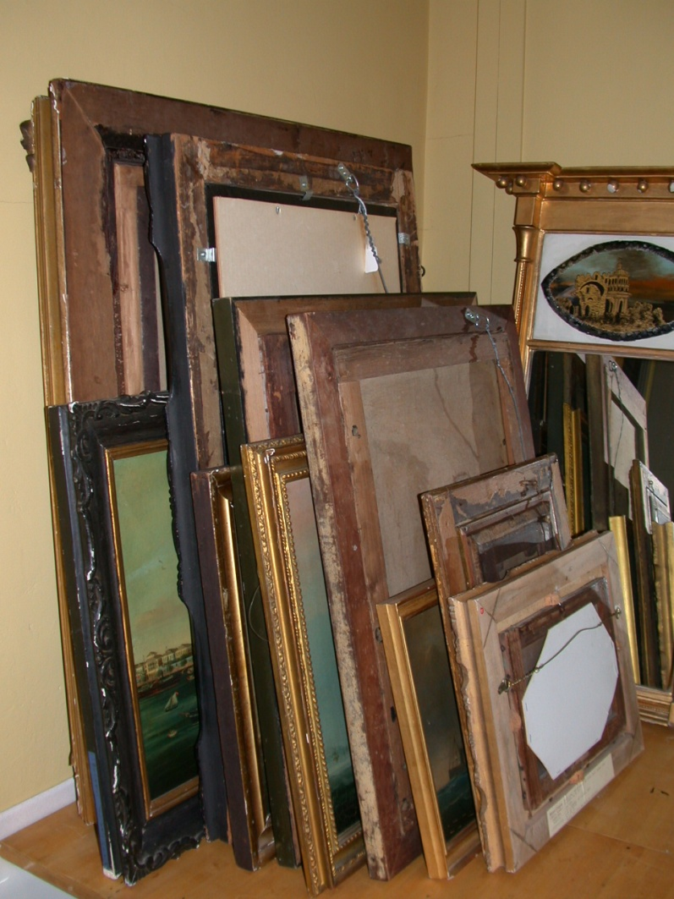
Packing out Needs
Clean covered surface
Padded blocks or foam padding
Interleave with cardboard
Ventilation
Clean absorbent cloth
Plastic bags, tape
Notes:
These are the supplies you will need when getting ready from triage and salvage.

Slide 42
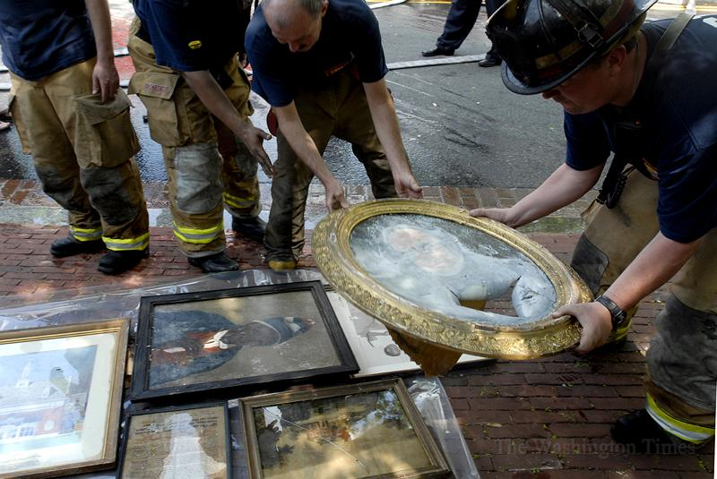
Packing out Process
Triage
Bag labels/identifiers
Cut from wall hangers
Do not remove from frames, bag up bits
Carry vertically
Avoid touching canvas
Ventilate until dry
Interleave, front to front, back to back
Notes:
Use common sense
Triage by priority and Wet/Damp/Dry
Be aware dirt and grime can disfigure and scar the surface (see upper ct wall mural)
Sometimes glazes are water soluble.
And of course mold is a common problem with exposure to hi RH and warmth.

Slide 43
Preferred salvage options for paintings
Dehumidification – Vendor
Air dry – In-house
Send to a conservator immediately (rare or unique items)
Notes:
From our list of options earlier…

Slide 44
Risks to Textiles
High risk to mold
Resistance to water damage
Vulnerable to structural damage
Dyes/corrosion transfer
Particulate embedding
Notes:
Textiles are high susceptible to mold.
Soot or soil can easily collect on textile surface and be very difficult to remove.
Wet textiles especially old ones are vulnerable to multiple kinds of structural damage
Such as severe weakening , Distortion from their components or their mounts shrinking or expanding. Black or dark brown fabrics are usually more fragile than other colors.
Some are Partly soluble..especially archaeological or severely degraded fabrics
Wet textiles, especially old one, are vulnerable to cosmetic damage from water including changes in color, finish, size or feel
Transfer of color within or among textiles
Staining from packing materials

Slide 45
Packing out Needs
Support materials
Blotting materials
Shaping materials
Plastic bags for bits
Notes:
Besides the recording tools and PPE, polyester webbing is needed for supporting wet materials. Blotting materials such as clean towels, diapers, sheets, cheese cloth or unprinted newsprint are useful
Waxed paper or polyethylene to separate textiles that are to be frozen, plastic bags fro freezing or isolating mold textiles is a useful supply.
Polyethylene sheeting to cover surfaces
A clean, secure space with clean work surfaces, good air circulation and a RH of less than 60%
Fans & dehumidifiers
Absorbent materials such as sheeting ,cheesecloth, or blank newsprint for blotting
Nonwoven polyester or nylon net for helping garments keep their shape while drying

Slide 46
Packing out Process
Triage
Don’t unfold or separate stuck pieces
Don’t open closures
Handle as little as feasible
Use a support when lifting
If fragile do not blot
Avoid stacking
Dry in normal shape
Notes:
Wet textiles can be heavy and extremely fragile. Handle them as little as possible. Lifting and manipulating must be done with great care and attention so they don’t rip
When moving wet textiles use a support such as such as sheets of polyester webbing (pet screening) fiberglass screening or boards or shelves covered with clean polyethylene.
Textiles that are rolled on tubes, like rugs, may be very heavy when water logged. Use a support such as a pipe inserted inside the tube for moving them.
Assess partially wet textiles to determine whether they should be rinsed (and made completely wet) and then frozen or dried, or dried as they are. Rinsing is indicated only if time permits and you think you can remove soil or staining without causing damage or color loss. Support the textile on plastic screening and rinse in a container of cool clean water.
Be sure to move moldy and or contaminated materials to an isolated areas ideally one with RH of 40-50%. Wear PPE and be careful not to spread mold out of the area.
Fragile before sturdy
Separate wet, damp & partially wet

Slide 47
Preferred salvage options for textiles
Air dry – In-house
Freeze – In-house or vendor
Vacuum freeze dry – Vendor
Send to a conservator immediately (rare or unique items)
Discard
Notes:
From our list of options earlier…

Slide 48
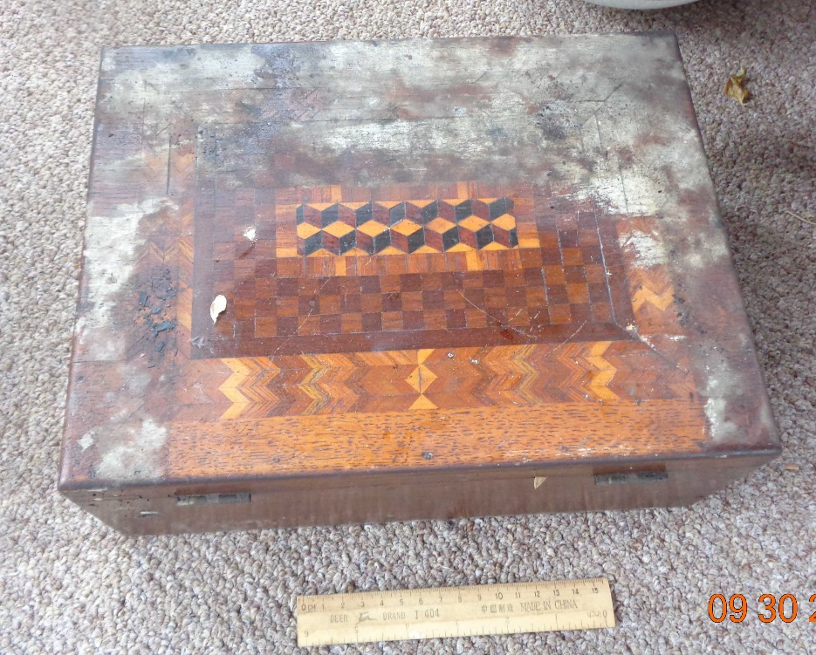
Risks for Wood
Distortions
Structural weaknesses
Softness to original finishes
Corroding metals

Slide 49
Packing out Needs
Clean space
Blotting materials
Bags/labels for broken parts
Dollies/handtrucks
Ventilation
Extra hands

Slide 50
Packing out process
Lift from undersides
Slightly open drawers
Blot excess water
Bag & Label parts
Ventilate
Avoid stacking
Move on dollies
Notes:
Priority pieces
Veneers before solid woods

Slide 51
Preferred salvage options for wooden objects
Dehumidification – Vendor
Air dry – In-house
Send to a conservator immediately (rare or unique items)
Discard
Notes:
From our list of options earlier…

Slide 52
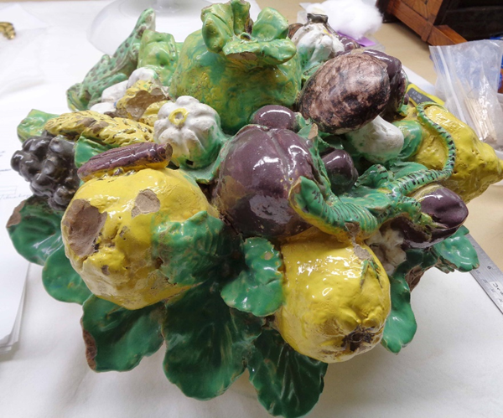
Risks to Ceramics/Stone
Chips and breaks
Absorption of pollutants by unfired ceramics or porous stone
Crazing and flaking of glaze

Slide 53
Packing out Needs
Blotting supplies
Bags & labels for parts
Packing/padding supplies/containers
Dollies/trollies

Slide 54
Packing out process
Triage by priority
Simple rinse/blot
Air dry
Individual padded crates

Slide 55
Preferred salvage options for ceramics and stone
Dehumidification – Vendor
Air dry – In-house
Notes:
From our list of options earlier…

Slide 56
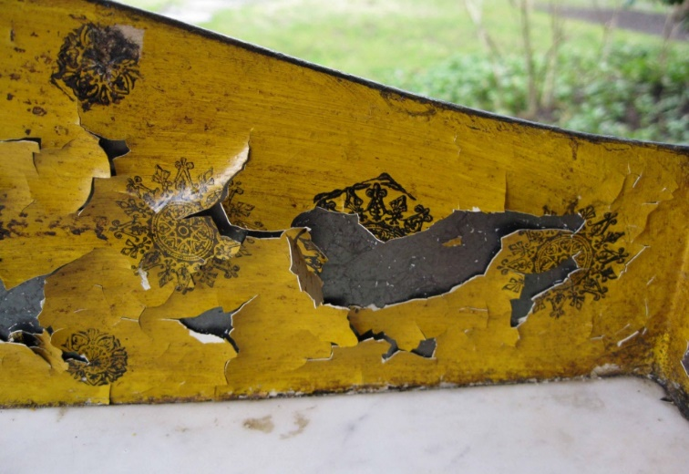
Risks to Metals
Corrosion
Fragile decorative finishes
Multiple components

Slide 57
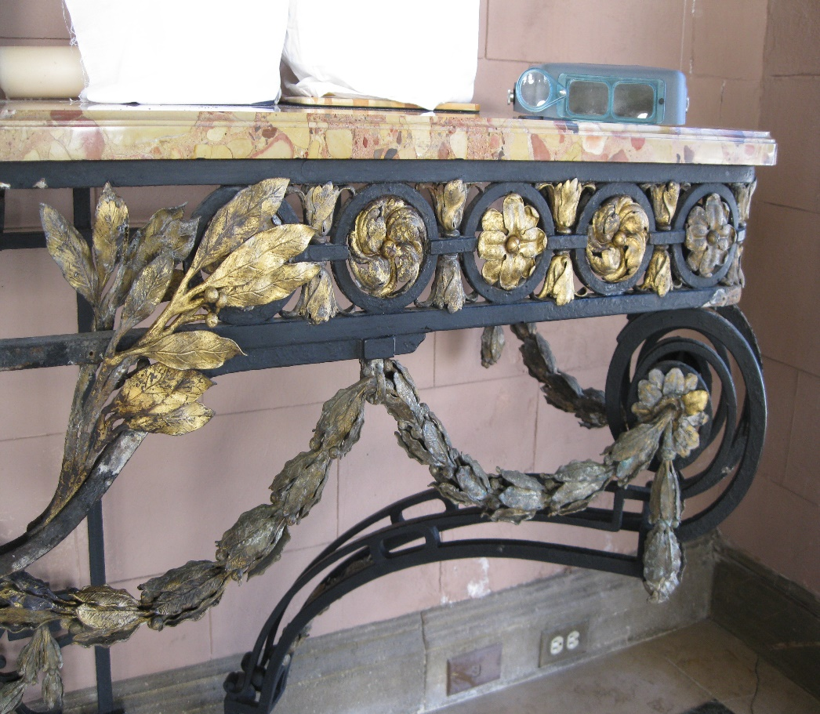
Packing out Needs
Rinse containers/sprayers
Blotting supplies
Bags for parts
Hair dryer
Notes:
Metals too may seem impervious, but in reality are affected by the acidic and grimy deposits that will exacerbate any corrosion that exists.
Many metals have composite parts. They can be painted (above) or have different attachments (bone in the silver pot or the remnants of fabrics as in the anchor)

Slide 58
Packing out process
Triage by priority
Simple rinse
Air dry/blot
Wrap in paper or
soft fabric
No tape
Crate individually or stack by weight

Slide 59
Preferred salvage options for metals
Dehumidification – Vendor
Air dry – In-house
Send to a conservator immediately (rare or unique items)
Notes:
From our list of options earlier…

Slide 60
Q and A

Slide 61
ASSIGNMENT
Complete the following three sections in the NEDCC Leaflet 3.4, “Worksheet for Outlining and Emergency Response Plan”, https://www.nedcc.org/free-resources/preservation-leaflets/3.-emergency-management/3.4-worksheet-for-outlining-an-emergency-response-plan
C. Emergency Equipment and Supplies – three tables, Life Safety, Facilities, and Collections Response and Recovery
G. Other Emergency Issues – e.g., training needs, drills, etc.
I. Salvage Priorities – this will be a bit time consuming but it’s VERY IMPORTANT!

Slide 62
ASSIGNMENT
Other Valuable Resources:
Connecting to Collections (AIC): “Appendix 7: Guidelines for Establishing Salvage Priorities” at A7pg3 EstablishingSalvagePriorities (connectingtocollections.org)
Heritage Collections Council’s Be Prepared: Guidelines for Small Museums for Writing a Disaster Preparedness Plan at https://tinyurl.com/yyrkgt7x . See pages 24-28, “Prioritise Collection (Significance Assessment)”
FAIC’s Field Guide to Emergency Response, https://tinyurl.com/y4nd3cev
AIC’s Emergency Response and Salvage Wheel, available at https://tinyurl.com/y59oye5a (keep one in each disaster kit)

Slide 63
THANK YOU!!!
Karen E. Kiorpes, kkiorpes@albany.edu
Donia Conn, conn@simmons.edu
Maria Holden, msholden1@aol.com

